Slide 1
LIQUIDS
CHAPTER 3

Slide 2
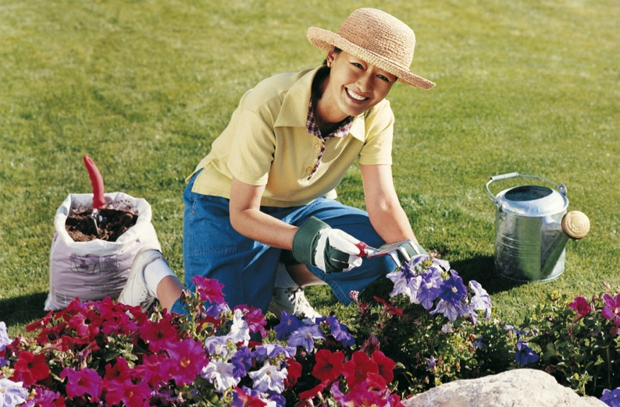
Celebrating liquids
Notes:
Li Ming was a retired woman who enjoyed working in her garden. Even the unusual heat wave that hit her region one summer didn’t deter her from tending her flowers and other plants. The temperature rose above 100 degrees Fahrenheit, and the humidity teetered at 90 percent. On the third day of these record-breaking temperatures, Li Ming called her daughter, Kim, but Li Ming sounded confused on the phone. Kim became alarmed and rushed to Li Ming’s house, where she found her mother lying on the kitchen floor, unconscious. Apparently, Li Ming’s large fan wasn’t enough to fight the effects of the heat and humidity, and she suffered heat stroke—which can be life threatening.¹

Slide 3
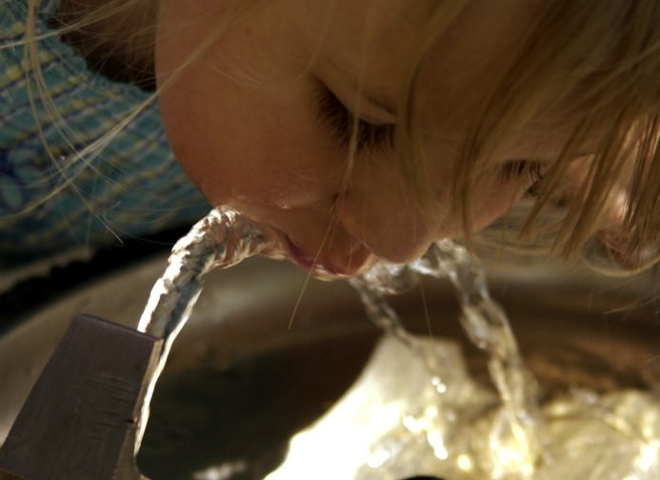
Next to air, water is the most vital element for survival
Notes:
One can lower the risk of heat-related illness, such as heat stroke, by drinking plenty of liquids, particularly water and fruit and vegetable juices. Next to air, water is the most vital element needed for survival.

Slide 4
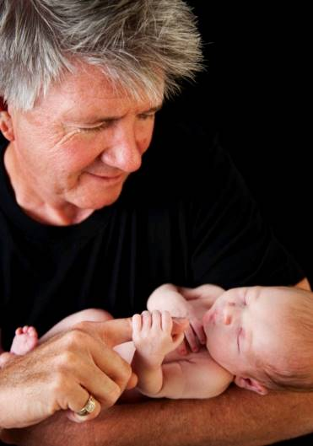
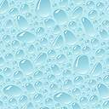
Man is about 70% water
70%
75%
Liquids 4
Notes:
By weight, a newborn infant is approximately 75 percent water, and an adult about 70 percent. A man weighing 198 pounds has about 138 pounds of water in his body.

Slide 5
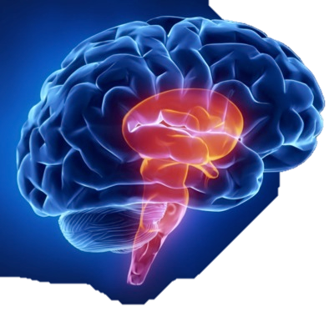
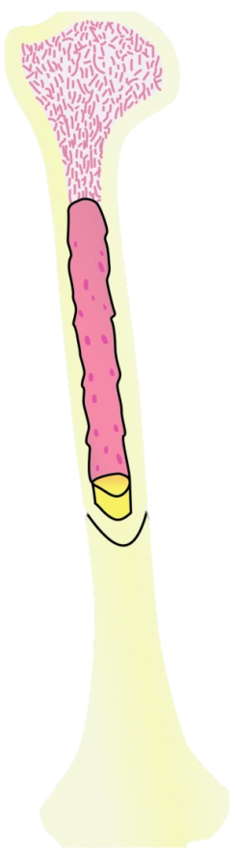
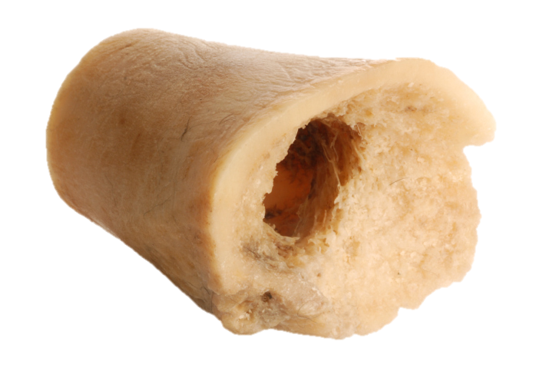
Brain about 85% water
Hard marrow bones are 20-25% water
Notes:
The gray matter of the brain is approximately 85 percent water, blood is 83 percent water, muscles are about 75 percent water, and even hard marrow bones are 20 to 25 percent water.²

Slide 6
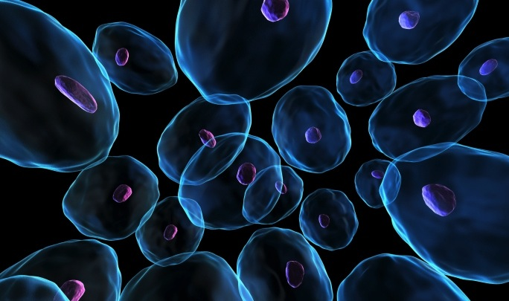
Almost every cell and tissue of the body requires water to perform its functions.
Liquids 6
Notes:
Almost every cell and tissue of the body not only contains water but is continually bathed in fluid and requires water to perform its functions.

Slide 7
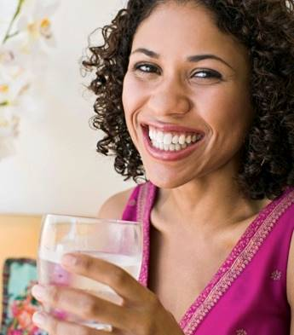
Water, the liquid of life
The transport system within the body
A lubricant for movement
The facilitator of digestion
Notes:
Water, the liquid of life, is a medium in which metabolism takes place. It is:
The transport system within the body
A lubricant for movement
The facilitator of digestion

Slide 8
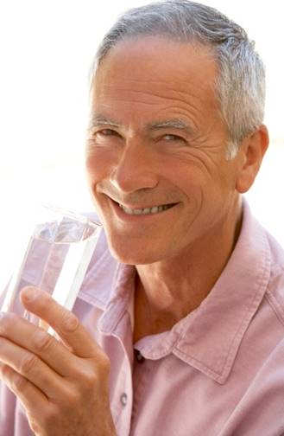
The prime transporter of waste via the kidneys
A temperature regulator
A major constituent of the circulating blood
Liquids 8
Notes:
The prime transporter of waste via the kidneys
A temperature regulator
A major constituent of the circulating blood

Slide 9
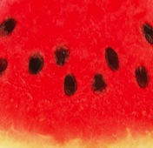
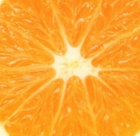
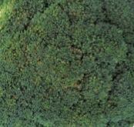
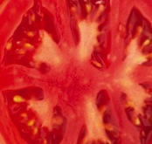
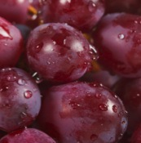
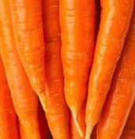
Liquid comes …
Two thirds from ingested liquid
One third from our food,
From a small amount of liquid synthesized during food metabolism
Notes:
About two thirds of the water our body requires comes from ingested liquid, about one third from our food, and a small amount of liquid is synthesized during food metabolism. Fruits and vegetables generally have higher water content than other food groups. Examples include: Apricots, watermelon, papaya, citrus, strawberries, apples, grapes, cherries, spinach, bell peppers, lettuce, carrots, cucumbers, squash, broccoli, celery, tomato.

Slide 10
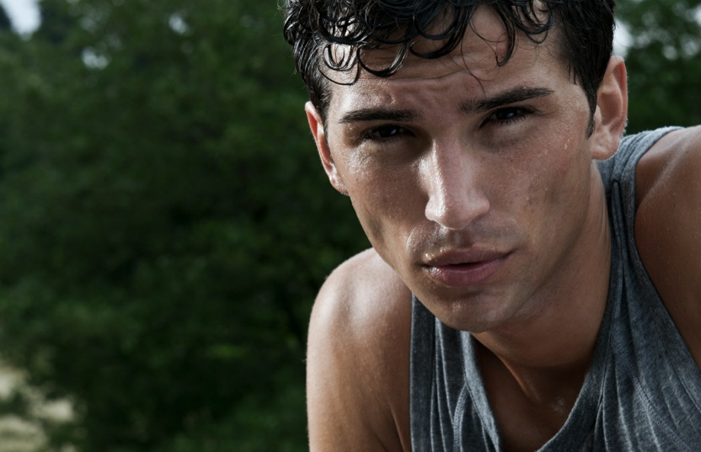
Maintaining balance
Daily Loss of
Water in Milliliters
Per Day of an Average
Human Body at
Normal Temperature
Prolonged
Low Prolonged Heavy
Activity Exercise
Insensible (invisible)
loss from skin 350 350
Insensible (invisible)
loss from lungs 350 650
Sweat 100 5000
Feces 100 100
Urine 1400 500
Total Output 2300 6600
Notes:
Ideally, the body maintains a balance between the amount of water lost each day and the amount taken in to replace it. The amount of daily water lost depends on climatic conditions and physical activities, as shown in the adjacent table.
The table shows that sweat is excreted 50 times quicker under conditions of prolonged heavy exercise compared to low activity in normal temperatures. The average human excretes a total of some 2,300 milliliters of water daily during low activity at normal temperature, and 6,600 milliliters in prolonged heavy exercise.³

Slide 11
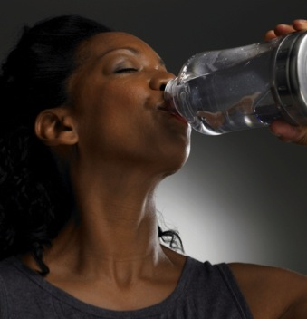
What if water intake is inadequate?
Decrease in sweat and urine output
Dehydration will occur
Rise in body temperature
Notes:
When we don’t provide our bodies with enough water, they attempt to avoid dehydration by decreasing sweat and urine output. If this compensatory mechanism proves inadequate and insufficient fluid intake persists, dehydration will occur.
Dehydration causes an impairment of the body cooling mechanisms, along with a possible rise in body temperature…

Slide 12
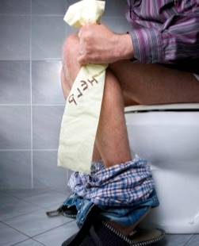
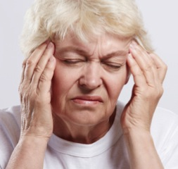
Insufficient water intake
Constipation—to the delight of the laxative industry
Dehydration may cause dizziness or headache
Increases the risk of developing kidney and gallstones
Notes:
Insufficient water intake also leads to constipation—to the delight of the laxative industry.⁴ Exercise and fiber intake play a role, as well.
Dehydration may cause a person to experience dizziness or headache. During prolonged, arduous exercise serious dehydration may occur, so careful attention to fluid intake is particularly important under these circumstances.
Drinking an inadequate amount of water also increases the risk of developing kidney and gallstones.⁵

Slide 13
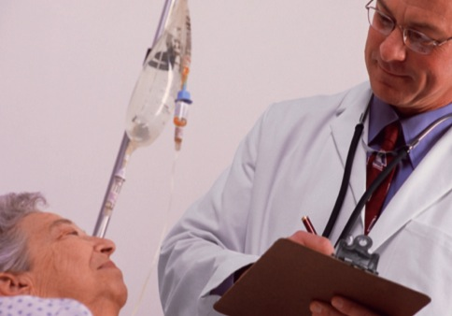
Journal of the American Medical Association (1995)
It’s estimated that adequate hydration of older people could save thousands of days of hospitalization and millions of dollars each year.
Liquids 16
Notes:
In 1995, The Journal of the American Medical Association called attention to the hazards facing older Americans from inadequate fluid intake.⁶ It’s estimated that adequate hydration of older people could save thousands of days of hospitalization and millions of dollars each year. Such an observation has implications for all age groups worldwide.

Slide 14
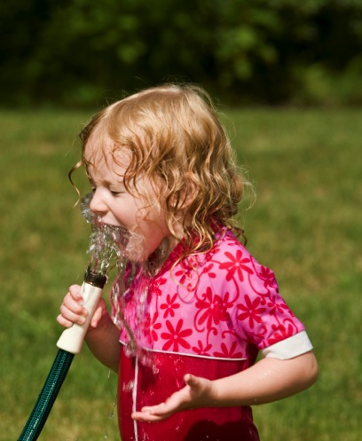
A practical guide to water intake
Consume sufficient amounts throughout the day to ensure that urine is a pale color
(urine may be bright yellow after taking certain medications/vitamins)
Notes:
To help stay hydrated during prolonged physical activity or in hot weather, the 2005 Dietary Guidelines for Americans recommends that we drink fluids during the activity as well as several glasses of water or other fluid after the physical activity is completed.⁷
In the healthy person, a practical guide to water intake is to consume sufficient amounts throughout the day to ensure that the urine is a pale color. (Urine may be a bright yellow color after taking certain medications, including vitamin pills and anti-tuberculosis medication.)

Slide 15
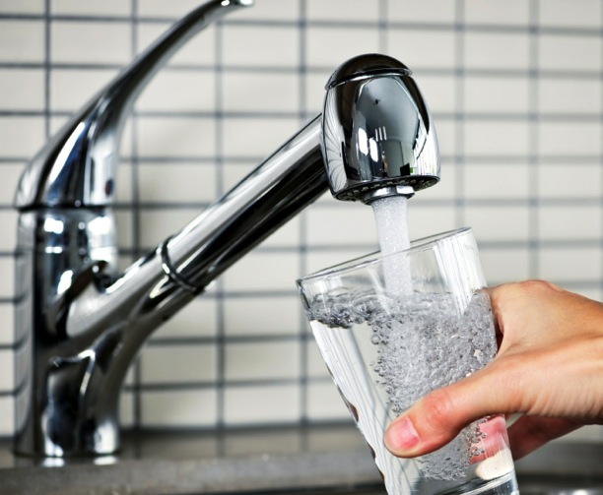
Begin drinking water in the morning
Notes:
Begin drinking water in the morning, because the body is relatively dehydrated from insensible (invisible) water loss, or perspiration, during sleep. Then continue to drink water at regular intervals throughout the day.
Be sure to drink water that is pure and clean. It is the most healthfully beneficial liquid we can consume because it’s relatively free of electrolytes and diuretic agents such as caffeine. Alcoholic drinks, apart from their other deleterious effects, are also diuretic agents. Most soft drinks are loaded with sugar, contributing to problems of obesity, diabetes, and dental caries.

Slide 16
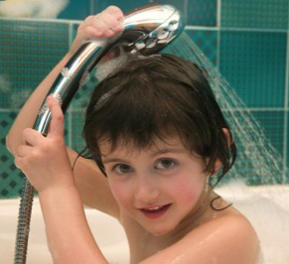
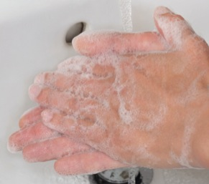
Water as a cleansing agent
Regular bathing removes accumulated dirt
Frequent hand washing before eating and after activities that soil their hands
Notes:
Another important use of water is cleansing. Regular bathing removes accumulated dirt and contaminating debris, reducing the risk of infection.
Frequent hand washing may reduce transmission of many infectious agents from person to person. If people thoroughly washed their hands with soap and water before eating and after activities that soil their hands, a large percentage of infectious diseases would be eliminated.

Slide 17
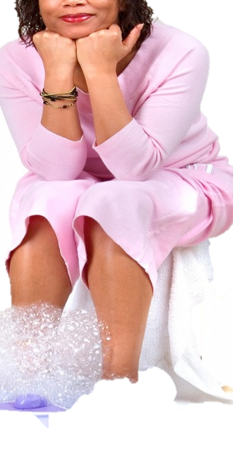
Hydrotherapy
Hydrotherapy is the use of water as a simple home therapeutic application. It’s best applied as a help for simple muscular aches, pains, and bruises.
Notes:
Hydrotherapy is the use of water as a simple home therapeutic application. It’s best applied as a help for simple muscular aches, pains, and bruises.

Slide 18
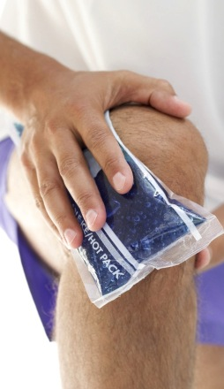
With muscular aches, alternately apply hot, wet towels and cold ones (end with a cold application). This will improve blood flow.
With bruises, cold compresses are more appropriate.
Liquids 21
Notes:
When dealing with muscular aches, alternately apply hot, wet towels and cold ones (end with a cold application) to affected areas. This will improve blood flow. If a recent injury and bruising have occurred, cold compresses are more appropriate.

Slide 19
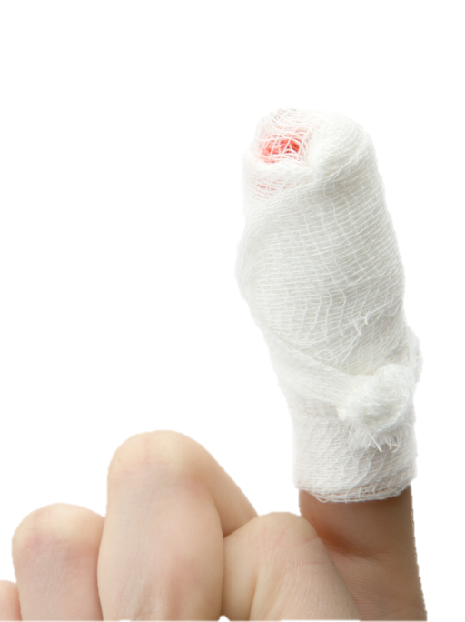
Caution should be exercised where skin is diseased or cut.
When blood flow becomes impaired or there is neurological damage, hot applications may lead to serious injury (diabetic patients)
Liquids 22
Notes:
Caution should be exercised where the skin is diseased or cut. When blood flow becomes impaired or there is neurological damage resulting in an inability to feel heat, hot applications may lead to serious injury, so caution is again advised. This is especially applicable to people with diabetes or those whose nerves have been damaged by injury or surgery.

Slide 20
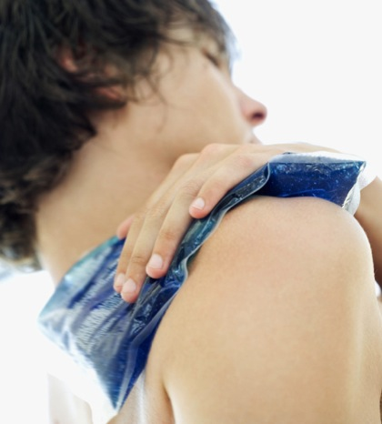
Modes of Hydrotherapy
Cold mitten friction
Hot foot baths
Heat compresses
Ice compresses
Liquids 23
Notes:
There are many modes of hydrotherapy, such as cold mitten friction, hot foot baths, heat compresses, and ice compresses. It’s unfortunate that so few utilize this most useful tool for relief.

Slide 21
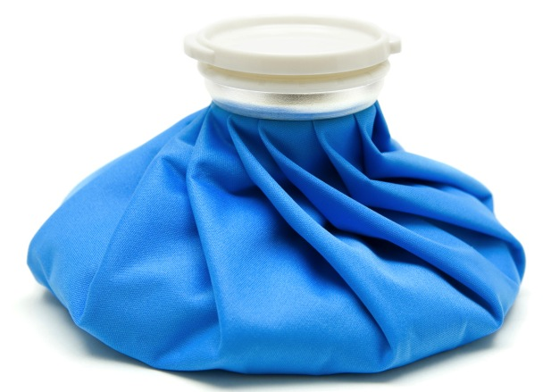
Ice bag
Notes:
A man injured his elbow during a badminton game. He would not listen to advice to compress the hematoma of his elbow with ice, which would reduce the bleeding. The next day the bruised area around his elbow had swollen so much that he went to see the doctor right away. The doctor advised the use of ice compresses at home, and charged a $100 consultation fee!

Slide 22
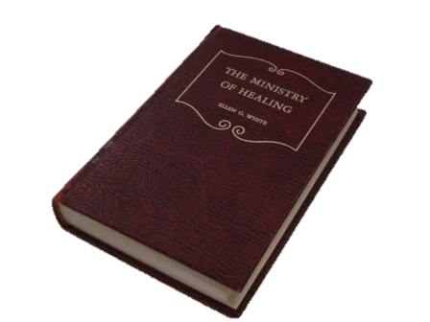
“The external application of water is one of the easiest and most satisfactory ways of regulating the circulation of the blood. . . . But many have never learned by experience the beneficial effects of the proper use of water. . . .
Liquids 25
Notes:
“The external application of water is one of the easiest and most satisfactory ways of regulating the circulation of the blood. . . . But many have never learned by experience the beneficial effects of the proper use of water. . . .

Slide 23
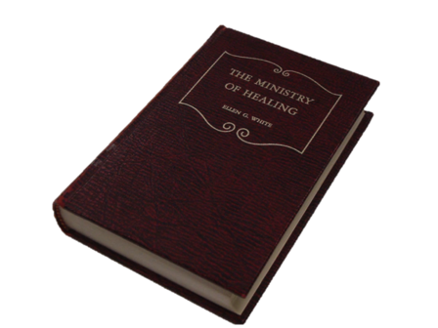
All should become intelligent in its use in simple home treatments.”⁸
Ministry of Healing p. 237
Liquids 26
Notes:
All should become intelligent in its use in simple home treatments.”⁸
Ministry of Healing p. 237

Slide 24
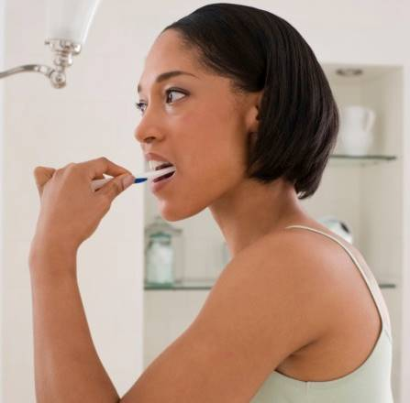
Appropriate concern for earth’s inhabitants
Avoid wasting water.
Notes:
Water is a precious and indispensable resource. It’s therefore important to conserve water resources:
Avoid wasting water. When possible, install toilets and shower heads in your home that use less water. When brushing your teeth, turn on the water taps only to wet and then rinse your toothbrush; turn taps off while brushing your teeth. Repair leaking faucets; continuous small drips over time can turn into huge amounts of wasted water. Also watch for other appropriate ways to conserve water in your day-to-day routines.

Slide 25
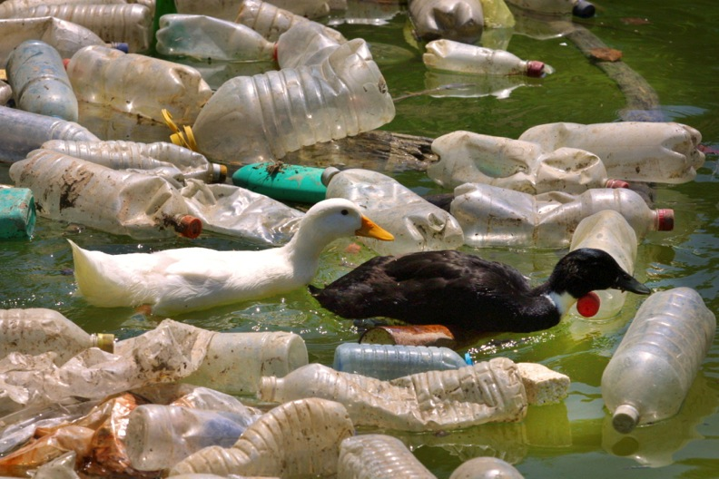
Avoid polluting water
Liquids 28
Notes:
Avoid polluting water. Water can be polluted by human excrement, industrial waste, and chemicals. Animals raised in large agricultural feed-lot operations consume huge quantities of water, and their excrement has the potential to pollute groundwater and nearby rivers and streams.

Slide 26
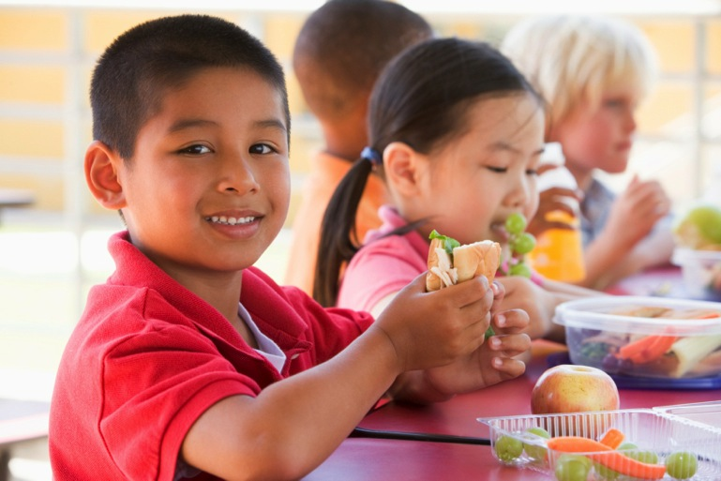
Eating a vegetarian diet
Liquids 29
Notes:
Eating a vegetarian diet helps to conserve water, because foods consumed in a plant-based diet require much less water to produce.

Slide 27
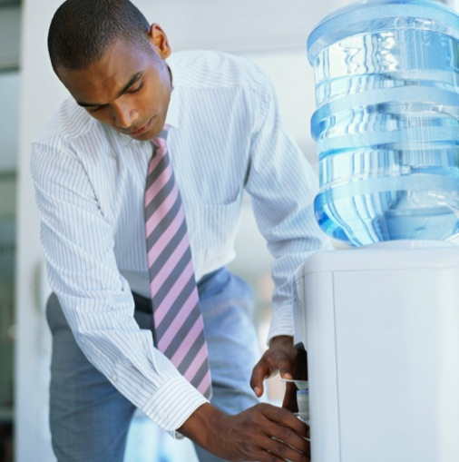
Water of Life
Notes:
Life cannot exist without water. All body functions require it. Water cleanses, refreshes, and powerfully aids the body’s restoration. Similarly, in our spiritual lives, we cannot live eternally without the Water of Life.

Slide 28
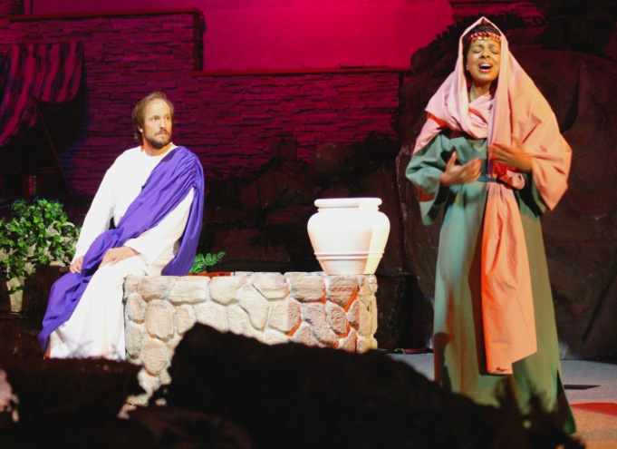
What does “Water of Life” mean?
Notes:
What does the term “Water of Life” mean? Two thousand years ago, Jesus Christ met a woman in Samaria who had come to a well to draw water. He asked her for a drink, and in the ensuing conversation He said He could give her water that would take away her thirst forever. “‘Whoever drinks of this water [from the well] will thirst again,’” Jesus told her, “‘but whoever drinks of the water that I shall give him will never thirst. But the water that I shall give him will become in him a fountain of water springing up into everlasting life’” (John 4:13, 14, NKJV). Such a concept implies a spiritual thirst-quenching that would satisfy the yearning for peace, joy, freedom from guilt, forgiveness, and a sense of oneness with God.
Christians find such a solution in the person of Jesus Christ. His life was in marked contrast to the turmoil, strife, jealousy, anger, and dissatisfaction among the people both of His day and ours. His offer to us all, is to come to Him and dedicate ourselves to His service. He promises that this will bring relief from toil, anxiety, and stress, providing rest and fulfillment in Him. His offer is still valid today. May we be transformed as we drink, bathe, and are soaked in His compassion, love, and acceptance.

Slide 29
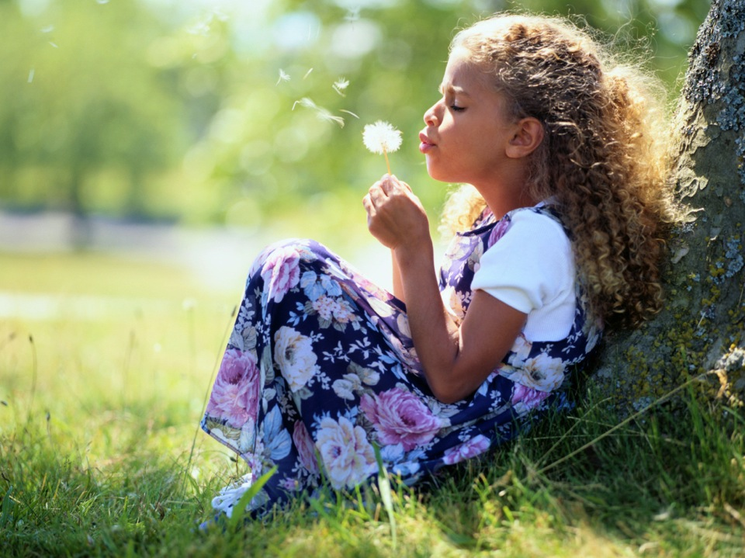
Life application questions
Notes:
Life application
questions

Slide 30
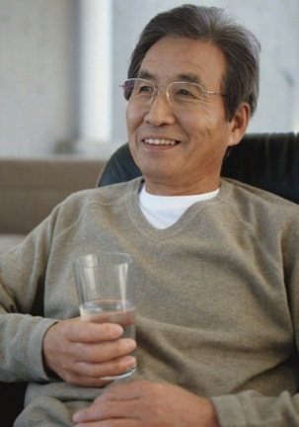
Based on my level of activity, how much water does my body lose daily?
Notes:
Based on my level of activity, how much water does my body lose daily?

Slide 31
Based on my level of activity, how much water does my body lose daily?
How much liquid am I taking in every day?
Notes:
How much liquid am I taking in every day?

Slide 32
Based on my level of activity, how much water does my body lose daily?
How much liquid am I taking in every day?
Based on the suggested criteria of the color of my urine, am I getting sufficient liquids on a daily basis?
Notes:
Based on the suggested criteria of the color of my urine, am I getting sufficient liquids on a daily basis?

Slide 33
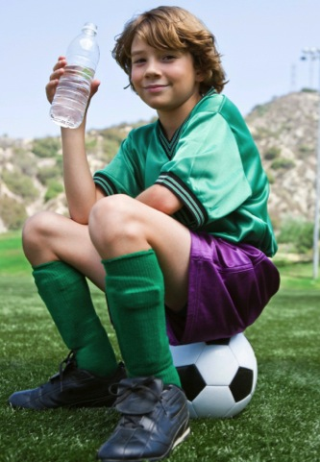
What can I do to increase my intake of liquids?
Do I need to fill a water bottle each morning and make sure I drink it all?
Notes:
What can I do to increase my intake of liquids? Do I need to fill a water bottle each morning and make sure I drink it all?

Slide 34
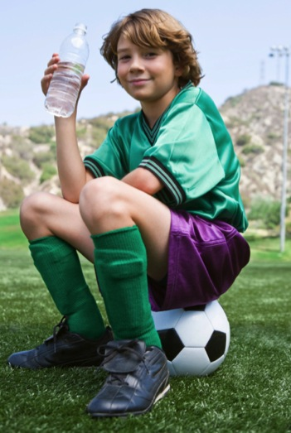
Would a schedule to drink at specific times each day be useful? Remember the important first glass in the morning.
Liquids 37
Notes:
Would a schedule to drink at specific times each day be useful? Remember the important first glass in the morning.

Slide 35
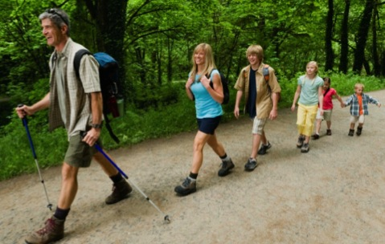
Ron and his family enjoy exercising outdoors. When it is hot and humid, they drink a lot of sodas to keep hydrated.
Sometimes they complain of headaches and dizziness. What is wrong?
Notes:
Ron and his family enjoy exercising outdoors. When it is hot and humid, they drink a lot of sodas to keep hydrated. Sometimes they complain of headaches and dizziness. What is wrong?

Slide 36
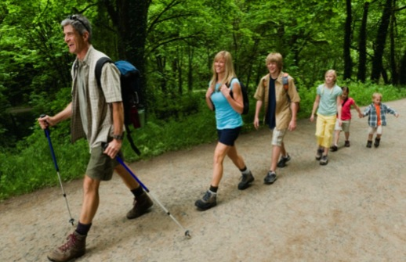
How could I encourage them to exercise but also keep them safe?
What are the symptoms of dehydration and heat stroke that I should look for?
Notes:
How could I encourage them to exercise but also keep them safe? What are the symptoms of dehydration and heat stroke that I should look for?

Slide 37
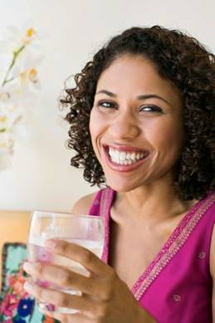
What percentage of my liquid intake is pure water?
Notes:
What percentage of my liquid intake is pure water?

Slide 38
What percentage of my liquid intake is pure water?
What drinks increase the chance of dehydration because they are diuretic in nature?
Notes:
What drinks increase the chance of dehydration because they are diuretic in nature?

Slide 39
What percentage of my liquid intake is pure water?
What drinks increase the chance of dehydration because they are diuretic in nature?
Do I consume too many sugary drinks (including fruit juices) that contribute to a weight problem?
Notes:
Do I consume too many sugary drinks (including fruit juices) that contribute to a weight problem?

Slide 40
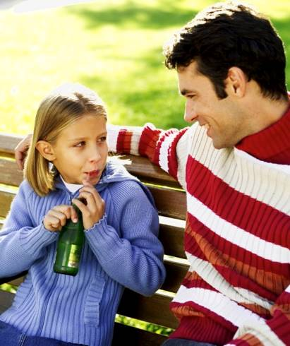
Do I make too many of these drinks readily available for my family, rather than keeping them for special times only?
Notes:
Do I make too many of these drinks readily available for my family, rather than keeping them for special times only?

Slide 41
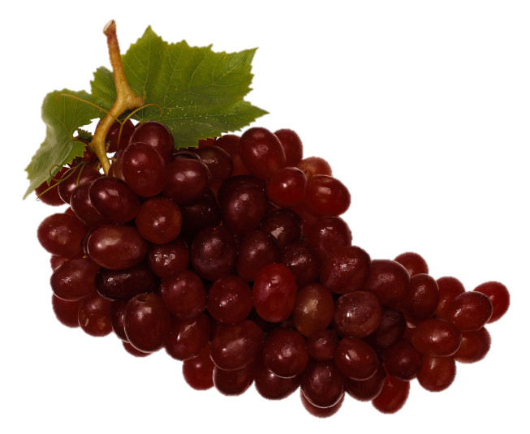
Because a third of the water my body gets comes from my food, do I need to reevaluate the amount of high-water foods I’m eating?
Notes:
Because a third of the water my body gets comes from my food, do I need to reevaluate the amount of high-water foods I’m eating?

Slide 42
Which of the fruits and vegetables mentioned that are high in water content am I going to choose to use more regularly?
Notes:
Which of the fruits and vegetables mentioned that are high in water content am I going to choose to use more regularly?

Slide 43
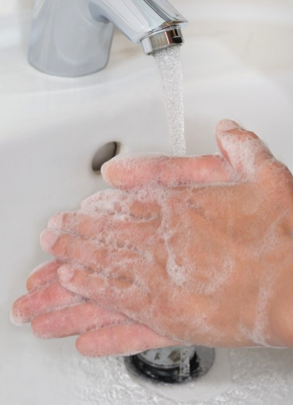
How often do I use water as a cleansing or healing agent?
Notes:
How often do I use water as a cleansing or healing agent?

Slide 44
How should I tactfully remind others to wash their hands more frequently in order to stop the spread of infections?
Notes:
How should I tactfully remind others to wash their hands more frequently in order to stop the spread of infections?

Slide 45
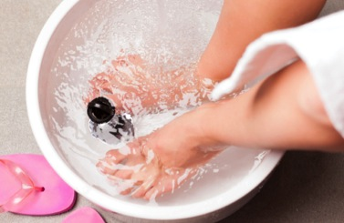
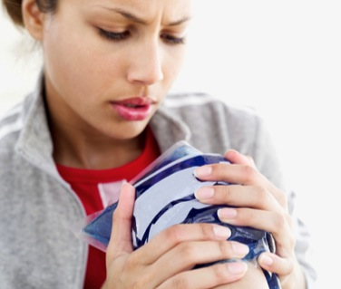
When is it appropriate to use hydrotherapy?
Do I have ice or ice packs in my refrigerator for use on bumps or bruises?
Notes:
When is it appropriate to use hydrotherapy? Do I have ice or ice packs in my refrigerator for use on bumps or bruises?

Slide 46
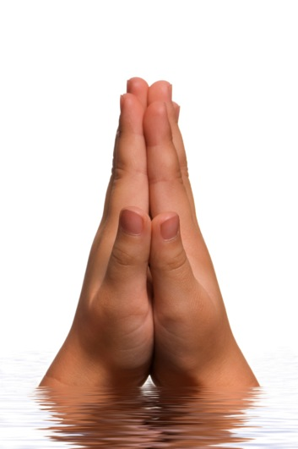
How often do I think about and thank God for the wonderful gift of sufficient water?
Which of the suggested ways to conserve water will I begin implementing?
Notes:
How often do I think about and thank God for the wonderful gift of sufficient water? Which of the suggested ways to conserve water will I begin implementing?

Slide 47


Which foods consume less water in production and reduce the amount of contamination of water supplies?
Notes:
Which foods consume less water in production and reduce the amount of contamination of water supplies?

Slide 48

Being thirsty reminds us of the greater thirst for the “water of life” that Jesus offers. How can I accept that gift so that I also can be a source of life to those with whom I interact on a daily basis?
Notes:
Being thirsty reminds us of the greater thirst for the “water of life” that Jesus offers. How can I accept that gift so that I also can be a source of life to those with whom I interact on a daily basis?

Slide 49
This presentation is created and distributed by the
Health Ministries Department General Conference of Seventh-day Adventists 12501 Old Columbia Pike Silver Spring, MD 20904
This presentation is shared for educational purposes only. The content, graphics, and pictures of each slide and the whole presentation must be kept intact if shared with other Health Ministries entities, including this page. Thank you for using and sharing only in a responsible manner.
Superscripts denote references listed in the back of the book, “CELEBRATIONS.”
Liquids 52

Slide 50
Imagery supplied by Stockbyte; BananaStock; Goodshoot; BrandX Pictures; Polka Dot; Photo and Co; iStockphoto; Ekaterina Krasnikova; Rob Friedman; Walter Zerla; Roman Shyshak; Aleksandr Stennikov; Grigoriy Lukyanov; Elena Elisseeva; Jan Tyler; Ingram Publishing; Vstock LLC; fotofermer; Francesco Ridolfi; akdemirhk; Francesco Ridolfi; Thomas Brostrom; Teresa Levite; Kati Molin; Christopher Robbins; George Doyle (Thinkstock).
Liquids 53

